Slide 1
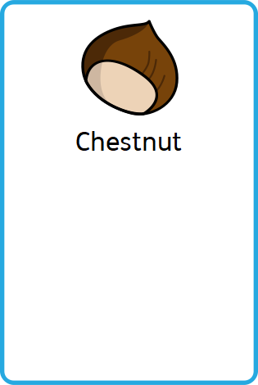
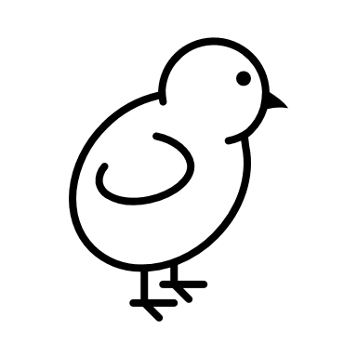
Spring Term Upper School Newsletter
Staff who work in Chestnut:
Teacher: Emma, Clare (Tuesday afternoon)
Teaching Assistants: Amanda, Carol, Tracey, Sara, Alison (Currently covering Carol)
Class symbol
Communication & Reminders
Please continue to check emails for any information and updates.
chestnut@chapelgreenschool.org.uk
A reminder about the £3 cooking money contribution per week. We have our sensory cooking session every Thursday morning, so we are asking for an £18 contribution in total. Please send in cash contributions to the class. There may not be a finished product to take home as our focus is mainly on the process and the skills. If cooking isn’t appropriate for your young person, the session will have a sensory focus with adapted activities. The same contribution will be due after half term.
School Website & Timetables
The school website has a vast amount of information to support you.
Below is a link to the website and a link to the curriculum umbrellas to explain timetable coverage.
www.chapelgreen.org.uk
https://www.chapelgreen.org.uk/docs/Curriculum_Umbrellas_Jan_2024.pdf
Enterprise & Provider Event:
Easter Enterprise Café
Thursday 27th March 2025
2-3pm – Enterprise Café, stalls & refreshments
From 2-5.30pm there will also be post-school providers in who parents/carers can talk to.
PE Days:
Monday – We will continue to have Rebound (not all students)
Tuesday – Hydrotherapy for all students – Swim kit needed.
Tuesday – We will also have a Dance & Yoga session.
Accreditation: KS4 & 5 students will continue working towards the ASDAN Lifeskills Challenges. KS3 will join in with the activities at a pre-accreditation level.
Offsite on Wednesdays: Chestnut students will continue to go offsite on Wednesdays to practise life skills and being out in the community. As we cannot always go out as a whole class there will be a rotation of students going out. We will contact you via email to let you know if your child is going out that week and what they will need.

Slide 2
How to Help your Young Person at Home
Literacy & Communication:
KS3 – Travel Magazines & Britain as an industrial nation
KS4 – Travel & Growth and sensory plants
KS5 – Travel Writing
What we do at school: Practise our communication with switches, objects of reference, symbols, core boards and Talk Pads (depending on needs of the student).A range of tasks focusing on our communication, reading, writing/fine motor and comprehension skills based on the theme.
What you can do at home:
Experience/look at different types of travel and destinations. Share books, magazines, comics. Listen to audio books, practise picking up small items, trace/write name and key words.
Maths & Problem Solving: Addition & Subtraction
What we do at school: Our main focus is exploring numbers, comparing – less and more, adding, subtracting (at appropriate levels of challenge). Practical maths will also be taught during our cooking sessions.
What you can do at home: Practise counting, comparing sets of objects. Add/take items away. Look out for numbers, shapes and patterns when out and about.
My Future: Life Skills/ Preparing for Adulthood (PfA): World of work, Future options
What we do at school: Experience and engage in role play and activities related to different types of jobs. Look at future jobs/careers.
What you can do at home:
Practise life skills - involve your child in household tasks e.g. pairing up socks, putting things away. What 'jobs' can they help with/do in and around the house? Visit shops, café's, places of work etc.
Creativity: Musical Theatre & Natural Art
What we do at school: Create works of Art and patterns using natural materials. Engage with the musical Matilda, focusing on characters, music and drama.
What you can do at home: Listen to songs from musicals, look at some of the amazing costumes. Create patterns with objects found at home.
Environment & Community: Types of water, land/water erosion, Sound & Light, Console/ICT games, Buddhism
What we do at school:
Learn about the topic appropriate to the student’s key stage and learn through videos, practical tasks, simple matching tasks etc. We have one R.E lesson per week. We will be focusing on Buddhism this half term, using our senses, learning key words and engaging with artefacts.
What you can do at home: Encourage your child to follow/research their interests. Listen to/watch factual programmes, try/smell/touch food from different cultures. Practise playing games on tablet or computer. Visit religious buildings in the community.
Personal Development: PSHE & PE:
What we do at school:
PSHE – Managing Feelings – learning about our feelings, strategies for managing them and using the Zones of Regulation.
P.E - Rebound for some students, Hydrotherapy/Swimming, practising dance and yoga skills.
What you can do at home:
PSHE- Encourage your child to express themselves and show/share their feelings. Model sharing, taking turns and how to be kind.
P.E- Go swimming if possible. Dance/move to music. Copy yoga moves in video clips.

